Slide 1

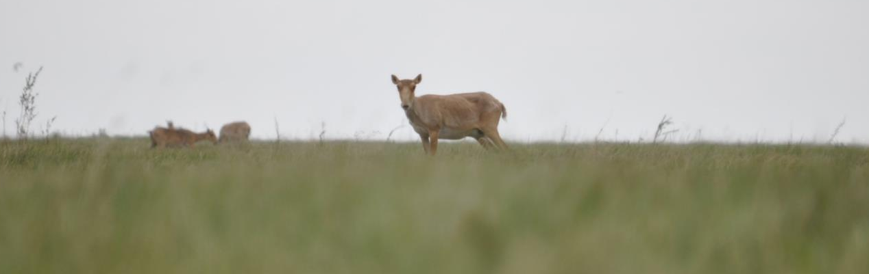
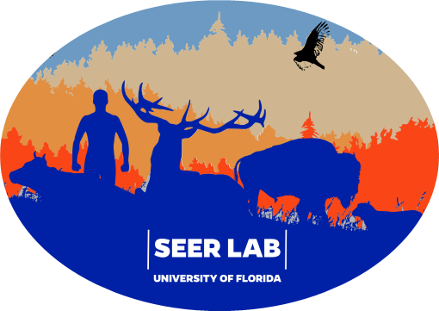
GIS: mapping epidemiological data and genotypes
Jason K. Blackburn
Jkblackburn@ufl.edu
Ian Pshea-Smith
ianpsheasmith@ufl.edu
Morgan C. Metrailer
morgan.metrailer@ufl.edu
GSEMOR 2025 – 6 May 2025
Reitz Union, University of Florida

Slide 2
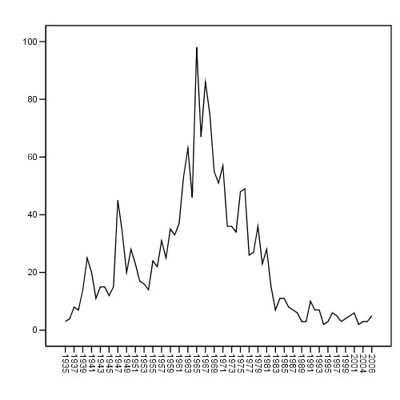
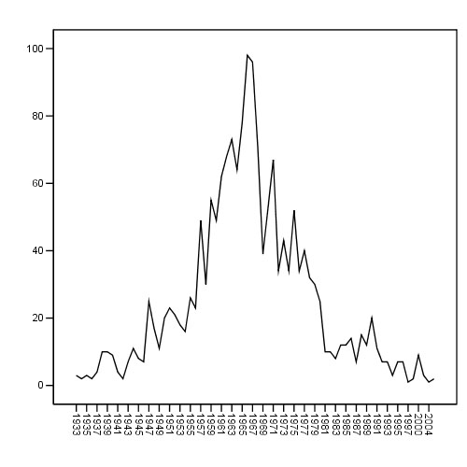
TOTAL OUTBREAKS BY SPECIES
(1937 – 2006) (Kazakh anthrax)
For spatio-temporal clusters, we used a 4-decade period; here we show annual cases, a typical epidemiological figure
Cattle
Sheep
Total outbreaks
Year
1960 - 1999

Slide 3
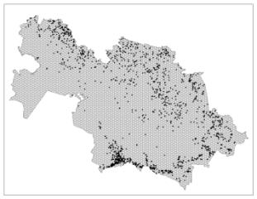
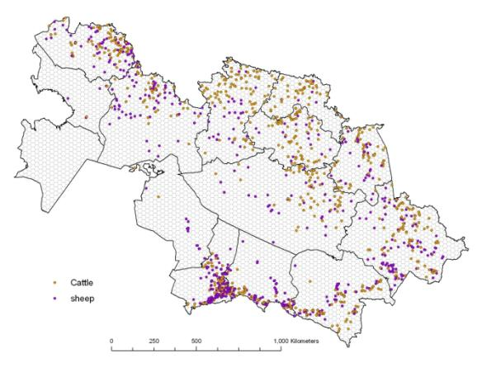
Spatial Epidemiology: Mapping Disease
cattle
Simple symbology and map analysis can present new patterns and create an environment for establishing new hypotheses to test with some probabilistic or deterministic technique
Now we can see differences in cattle and sheep outbreaks
sheep

Slide 4
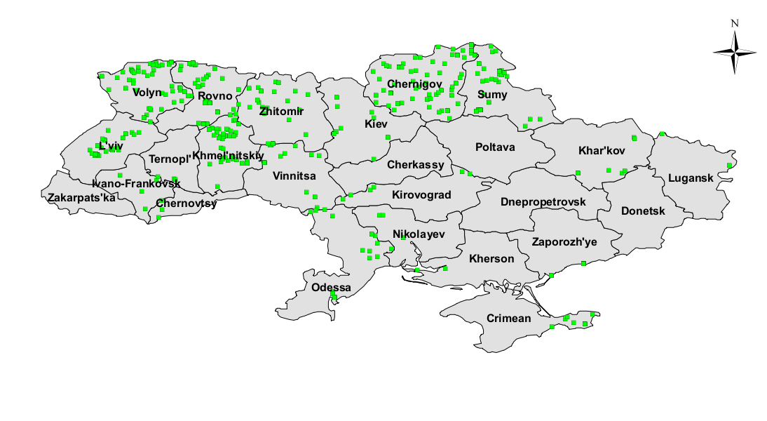
Historical Distribution Analysis Tularemia example (Ukraine)
Country level by date

Slide 5
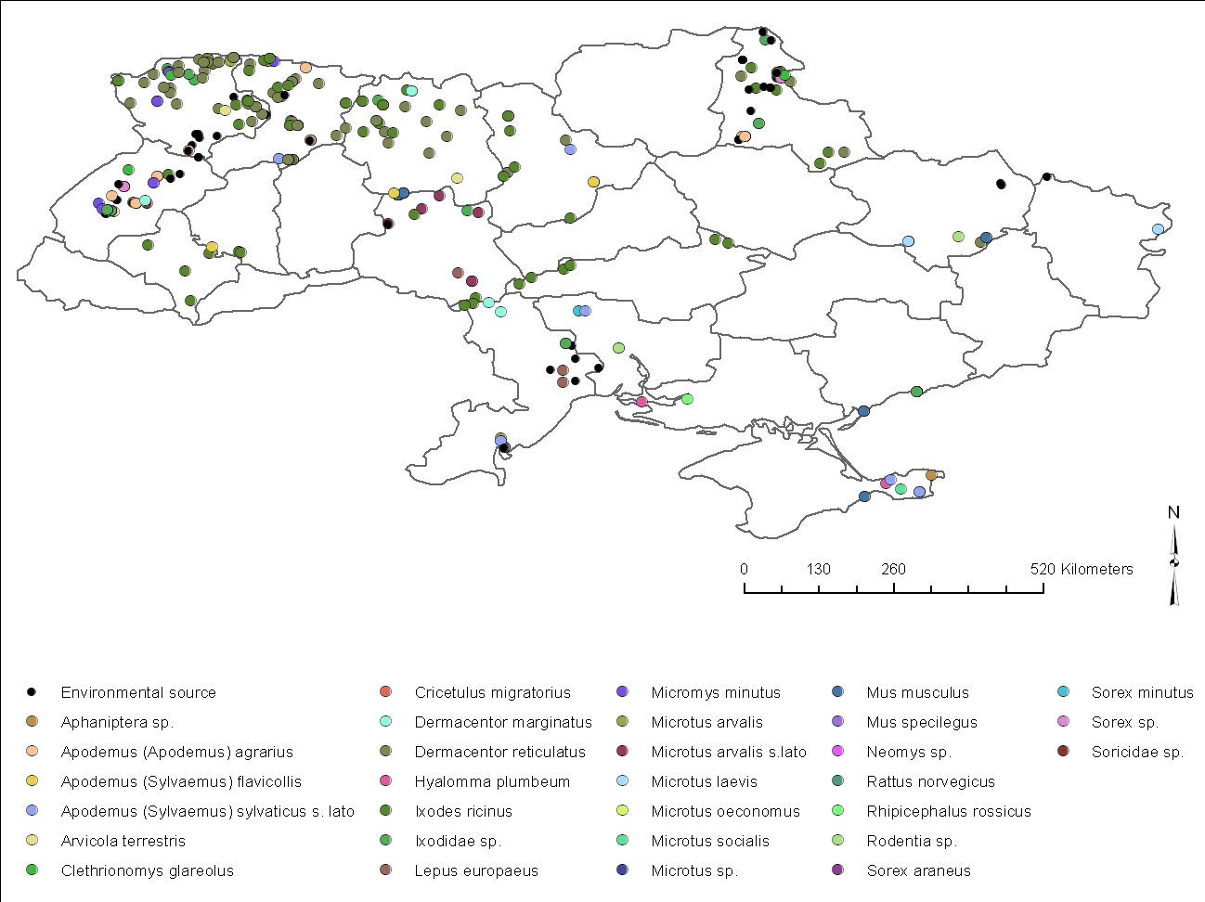
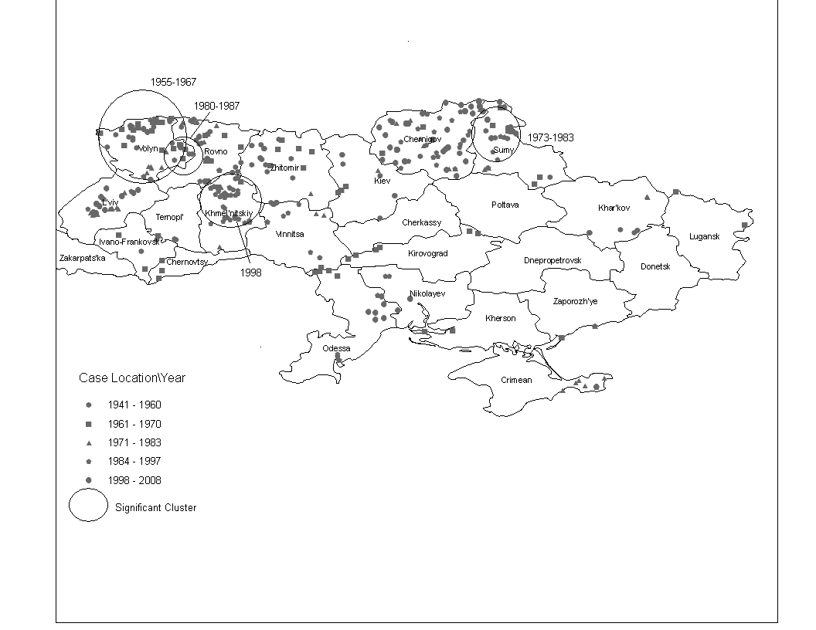
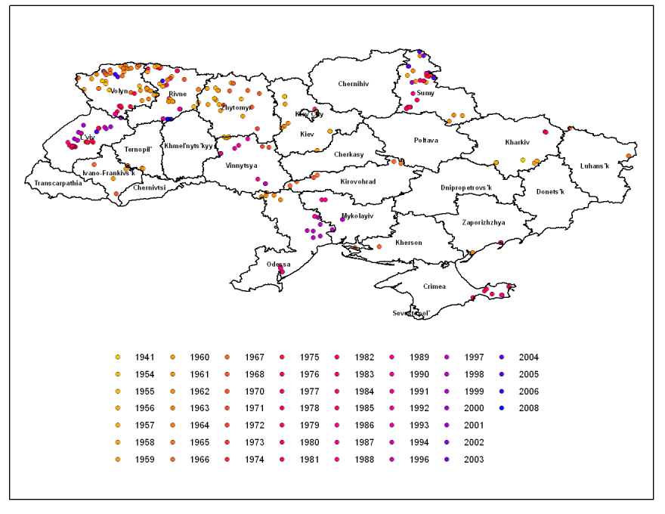
Historical Distribution Analysis Tularemia
Host/vector species diversity
Space-time clusters of isolates
Temporality of isolations
Notes:
The two on the left were added from the UP-2 AAG Poster

Slide 6
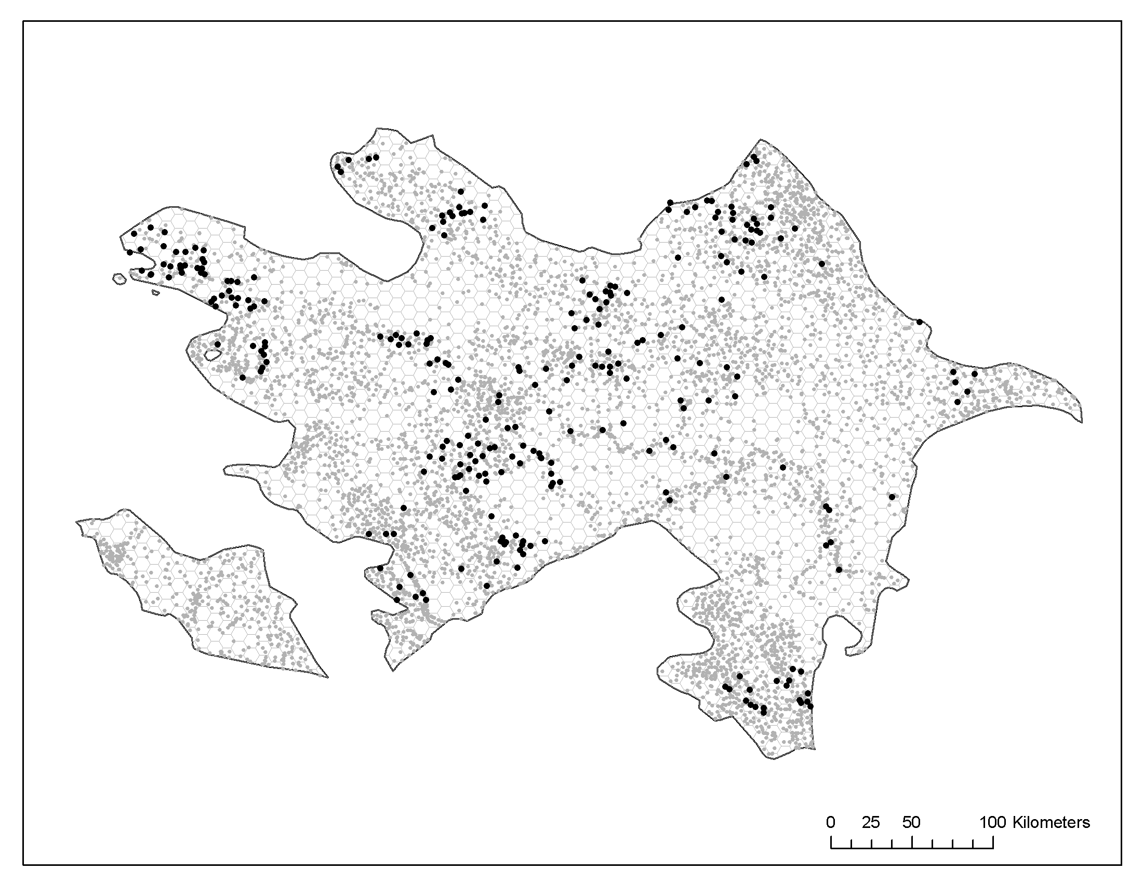
Historical Distribution Analysis Anthrax in Azerbaijan

Slide 7
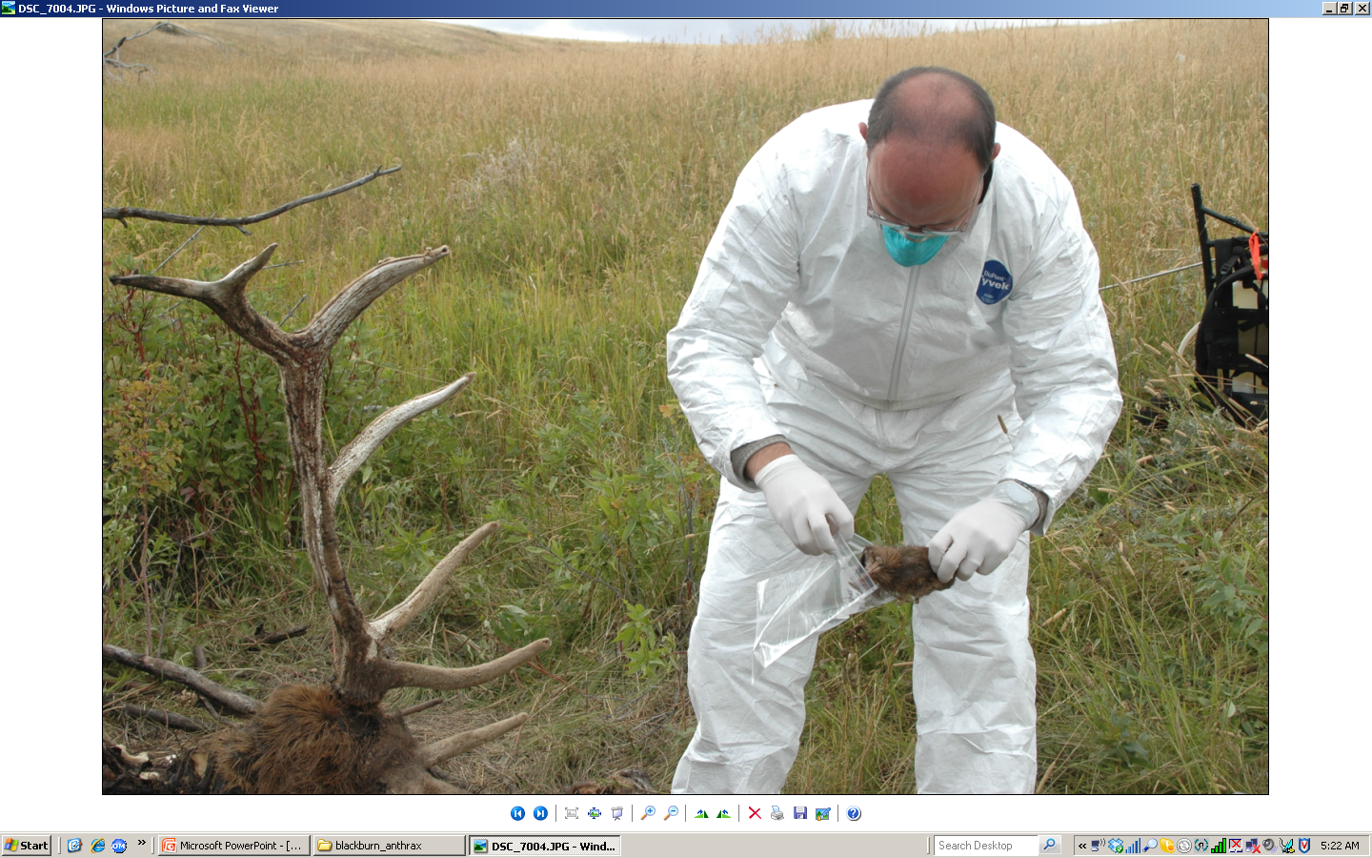
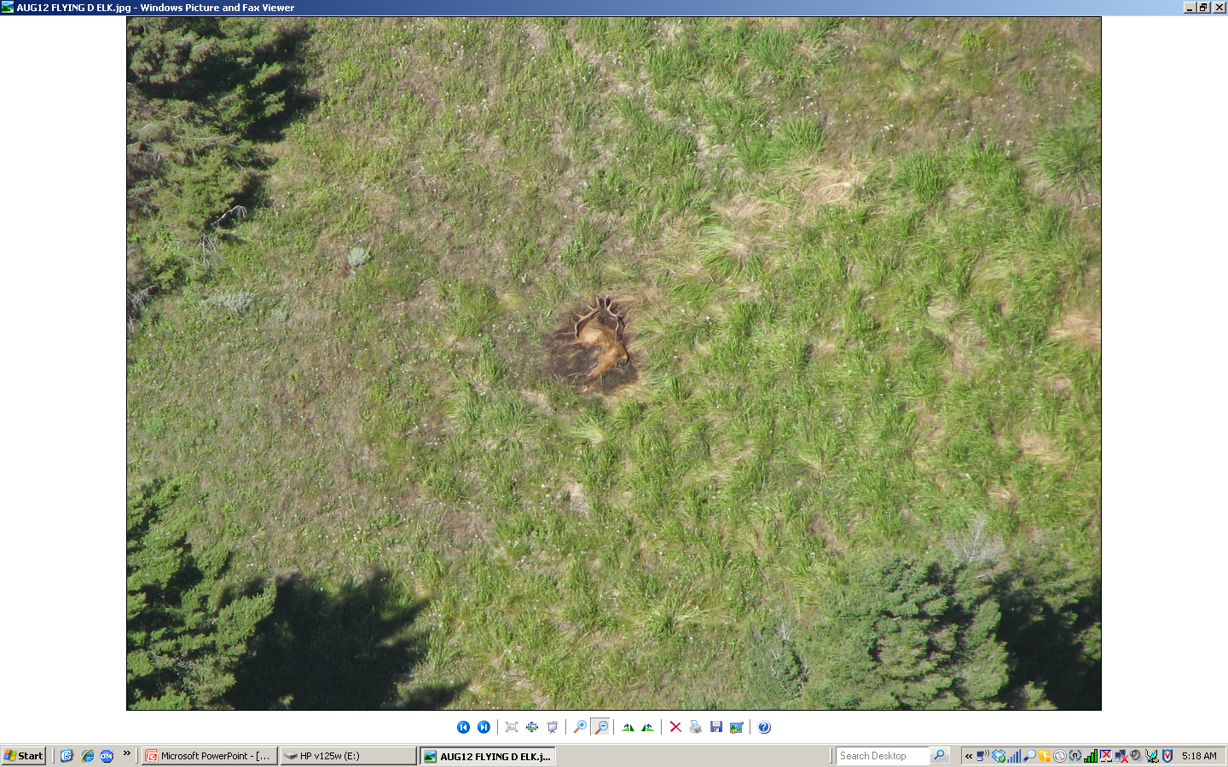
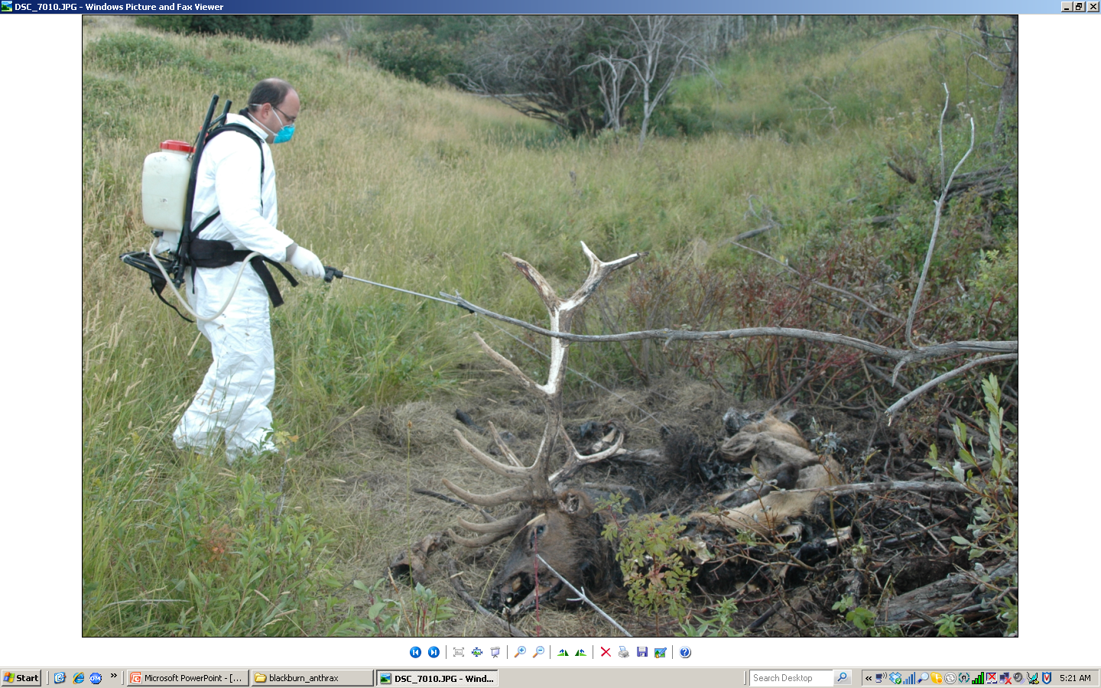

Slide 8
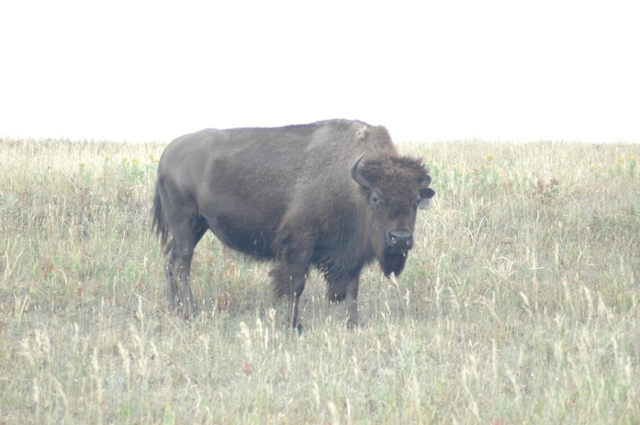
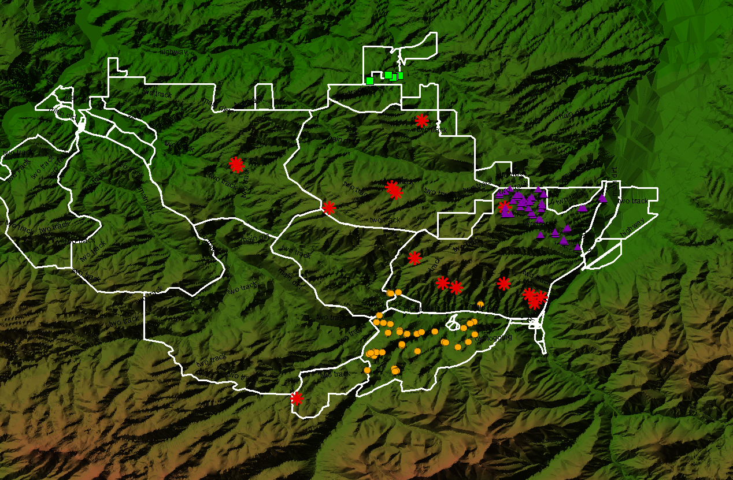
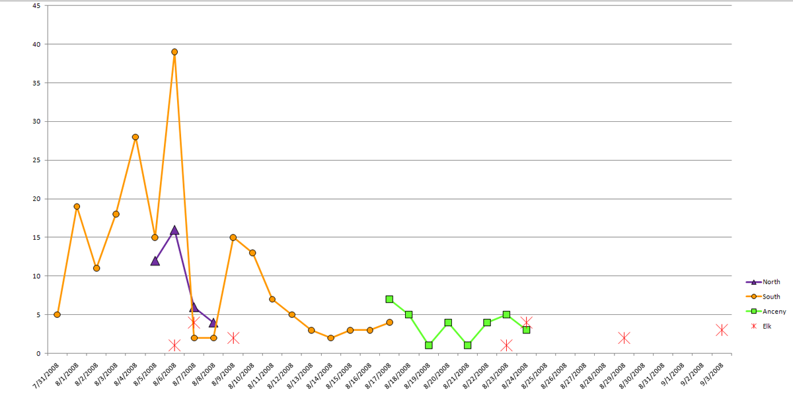
Here field outbreak data and elevation data were combined in a GIS to evaluate the distribution of anthrax-supporting habitats in western Montana.

Slide 9
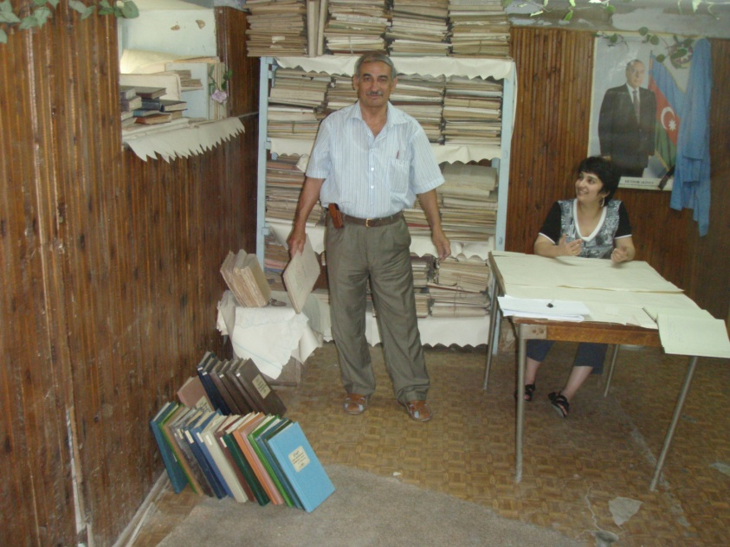
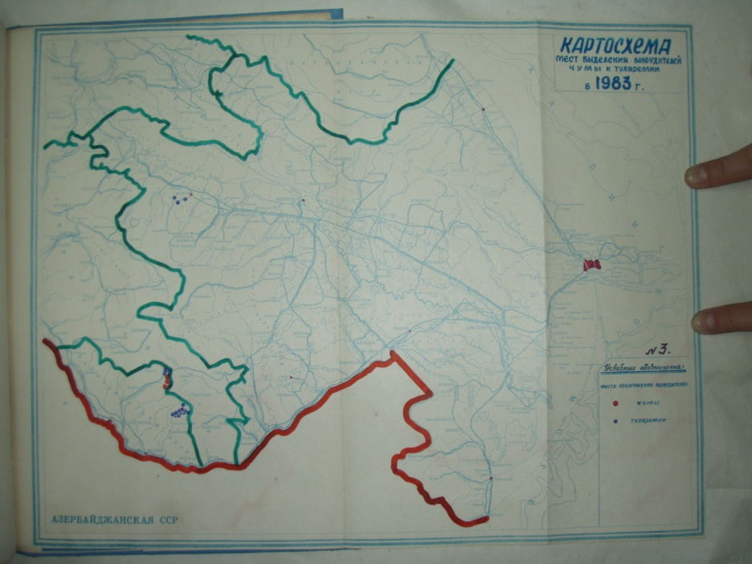
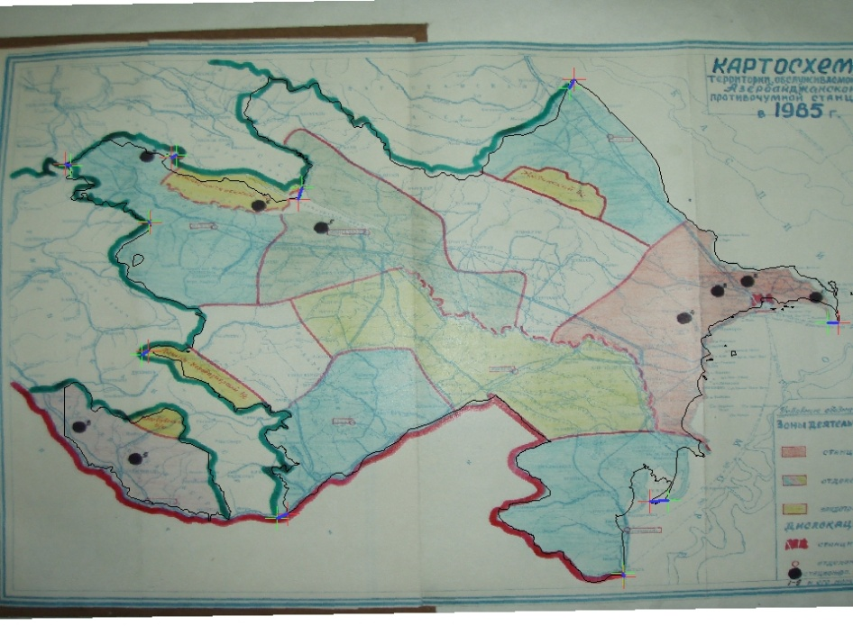
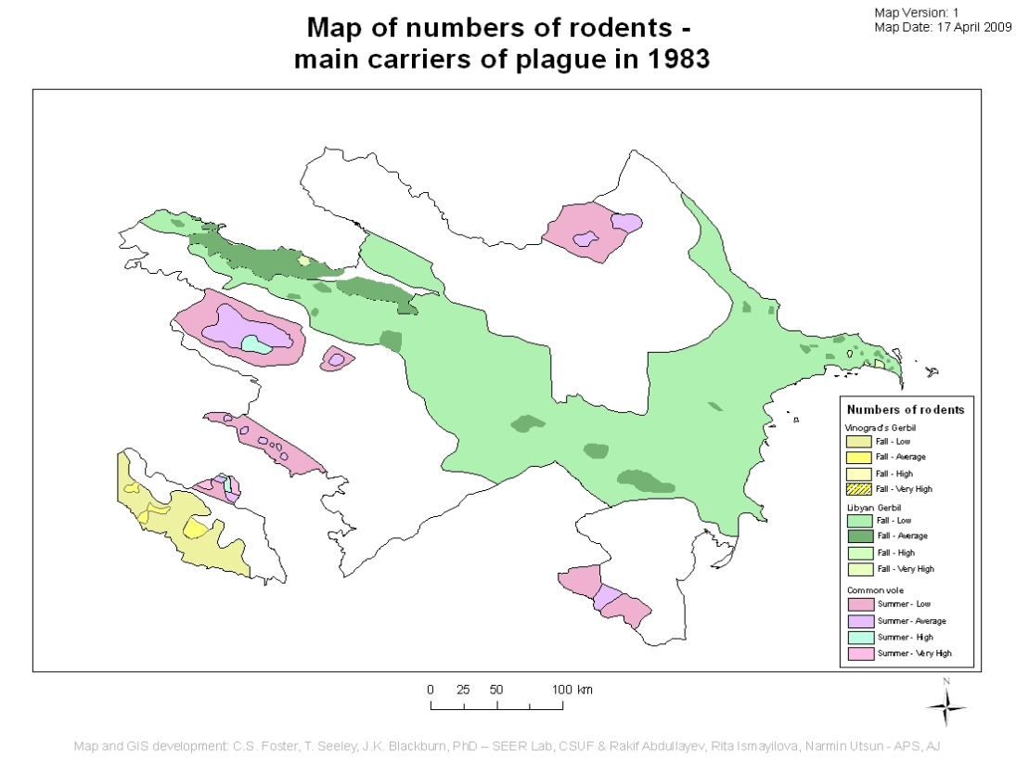
Here historical maps were scanned, digitized, and converted to functional GIS layers to study plague in Azerbaijan.

Slide 10
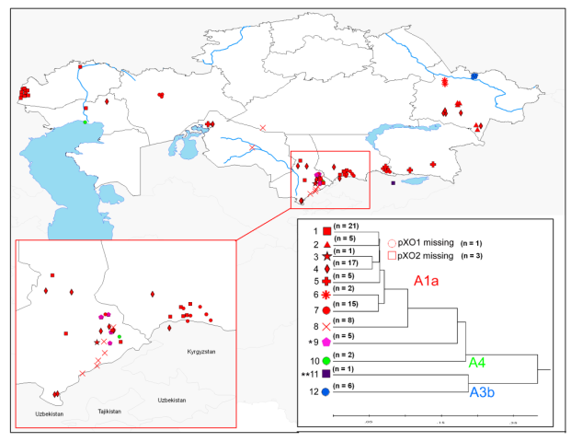
Spatial Epidemiology: Mapping Disease
Geospatial data can be combined with genetics data (here MLVA-8) to evaluate strain diversity of the pathogen.
Here Bacillus anthracis diversity for a 92-strain culture collection from the KZ-1 project.
Aikimbayev et al. (2010– Emerging Infectious Diseases)

Slide 11
Kernel Density Estimation:
ArcGIS Spatial Statistics, Kernel Density and Hotspot Identification

Slide 12
Descriptive Spatial Statistics
Today’s material requires the use of spatial descriptors to setup the KDE that will be used.
The Mean Center was calculated for each species in 2006. This is the mean latitude and longitude coordinate pair for the carcasses.
The Spatial Standard Deviation is used as a measure of overall directional dispersion. Here we present a 2 SD ellipse for each species for 2006 to illustrate the directionality of 95% of all the cases for buffalo, zebra, and elephants.
The Spatial Standard Distance is used as a measure of overall dispersion around the mean center. While the directionality component is not captured, this illustrates the scope of dispersion in each species. This measure is also used in the calculation of the optimal bandwidth for employing the Kernel Density Estimation (KDE) to visualize concentration of cases.
Notes:
The average nearest neighbor index (ANNI) was used to test for clustering of anthrax carcasses for each species, buffalo, zebra, and elephant, for each year from 2004 – 2008. ANNI was calculated using the Spatial Statistics toolbox in ArcGIS 9.3.1. Results are tabular and summarized with p-values in the results section. Values less than 1 reflect clustering, where average distances between cases (observed) were closer together than expected by random chance. Anthrax cases clustered when Z-scores were less than -1.96 or alpha = 0.05.
This statistic is useful for quickly determining whether or not cases are clustering spatially in any given species in any given year. While the location of the cluster is not identified the phenomenon is. Further analyses are under way to locate spatial clusters using spatial and spatio-temporal scan statistics in SaTScan, to be completed in August 2011.

Slide 13
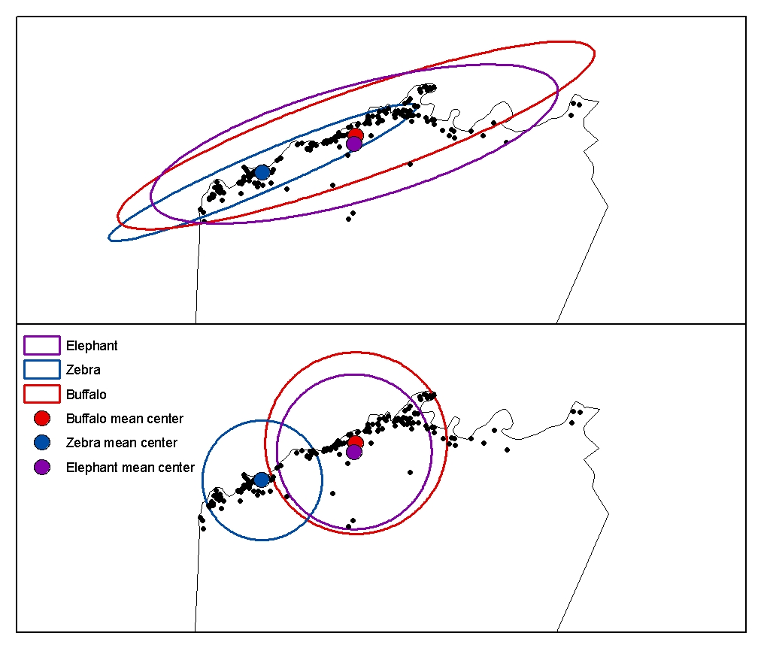
Descriptive Spatial Statistics 2006
Directionality of cases
Dispersion of cases
Notes:
Top Box: This analysis illustrates that the mean location of buffalo (red dot) and elephants (purple dot) were very near each other in 2006, with zebra (mean as blue dot) cases more heavily distributed southwest of the buffalo and elephant cases. The ellipses represent the 2SD of spatial locations, or the directionality and distribution of cases around the mean center. Buffalo where more broadly distributed in all directions, with zebra cases the least. Elephant cases extended further south in 2006 than the other two species, with the concentration of cases more similar to buffalo than zebra.
Bottom Box: The circles illustrate the 1 SD standard distance, or a measure of dispersion around the mean center. The larger the circle, the greater the dispersion of cases geographically (with no measure of directionality). Buffalo were more wildly dispersed from the mean center than the other two species during the 2006 outbreak year. Zebras were the least dispersed from the region in the southwest of the cases.

Slide 14
Kernel Density or Point Density?
Point density is a simple calculation of points per unit area; in ArcGIS this will be a gridded raster surface at a defined cell size (set by the user)
KDE uses a distance decay-based function to estimate higher values at the point locations and diminish as the distance away from the point increases
Can be used to identify local “hotspots” across the landscape using point data sets

Slide 15
What is Kernel Density Estimation?
Employs a gridded surface, a kernel (with fixed) and case data to derive spatially smoothed surfaces that distribute cases across a landscape
KDE is a smoothed visualization of case “concentration” – density estimation is a prediction of the distribution of events across a landscape based on values at available point locations
Can be used to identify local “hotspots” across the landscape using point data sets

Slide 16
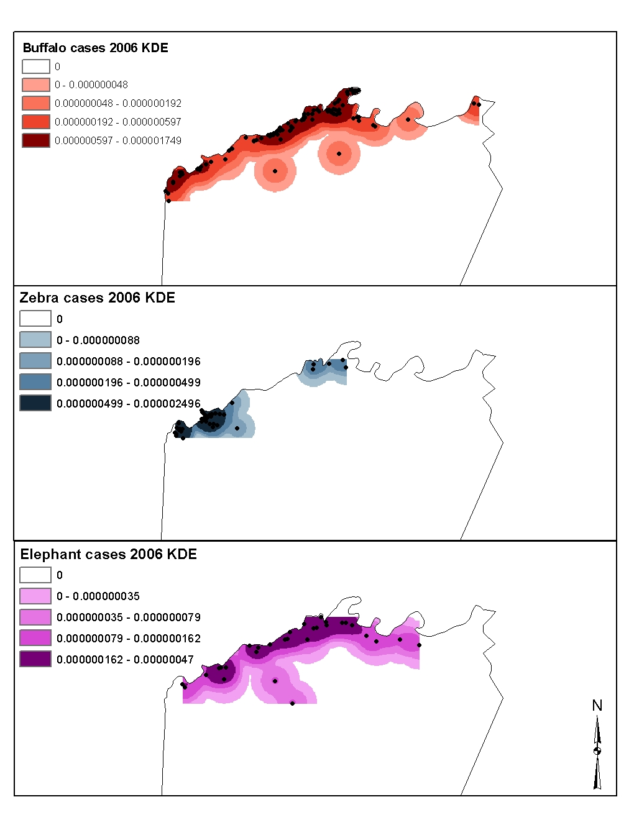
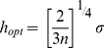
Kernel Density Estimates by Species 2006
Species | n | Standard distance | hopt
Zebra | 41 | 6831.79 | 2439.58
Buffalo | 105 | 10382.18 | 2930.68
Elephant | 31 | 8851.35 | 3389.58
All distances are in meters
Blackburn and Alexander (In Preparation)
Notes:
The spatial distribution of cases in 2006 for each species. The darker the color the greater the concentration. Notice that zebra show the most spatially concentrated cases of the three species, with buffalo distributed in high concentration along the riverfront, with two major concentrations, one in the north central and one associated with the zebra focus. Elephant cases were more similarly distributed as buffalo, with two hotspots. Hotspot analysis with KDE as first introduced for anthrax in 2010 looking at outbreak data from cattle and sheep in Kazakhstan. There too, different species showed different hotspots. These may be associated with specific habitats or specific animal movement patterns associated with the time of year and available forage.

Slide 17
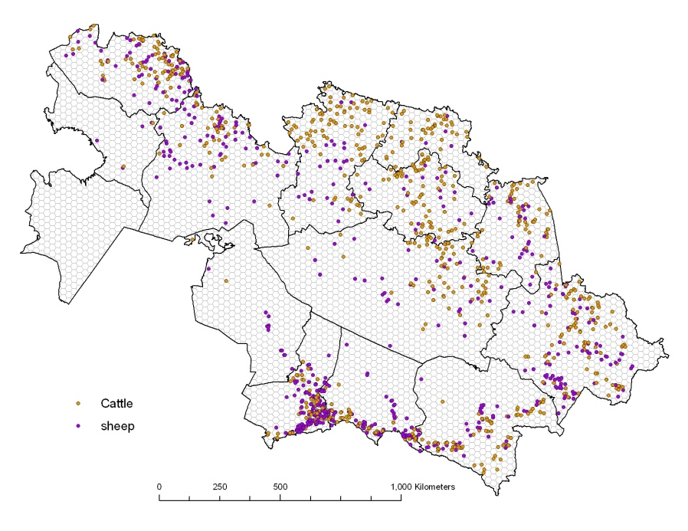
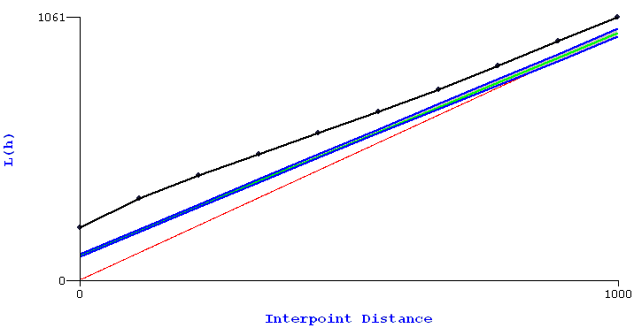
Cluster detection
Global – Is there Clustering
Local – Where are clusters, structure of clusters, scale of clusters
Employ point-pattern-analysis (PPA) or group-level spatial autocorrelation
Sagiyev et al. (2007)

Slide 18
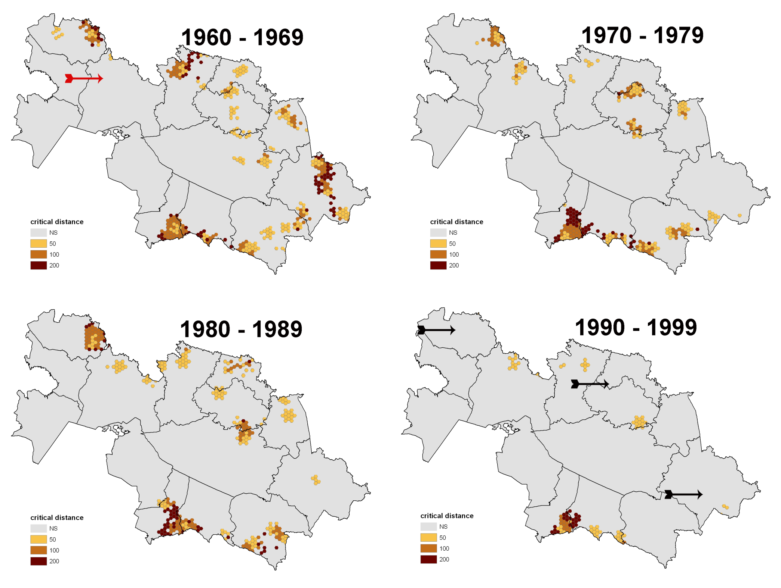
Notes:
Figure 4. Decadal spatio-temporal clusters of anthrax outbreaks in cattle from Kazakhstan during the period 1960 – 1999. Color ramp indicates the spatial scale of the cluster, as determined by the critical distance for that g-score. Black arrows indicate areas where significant clusters of outbreaks disappeared during the study period, while the red arrow indicates an area where a cluster developed in the latter decades of the study period. Cluster data adapted from Sagiyev et al. (2007).

Slide 19
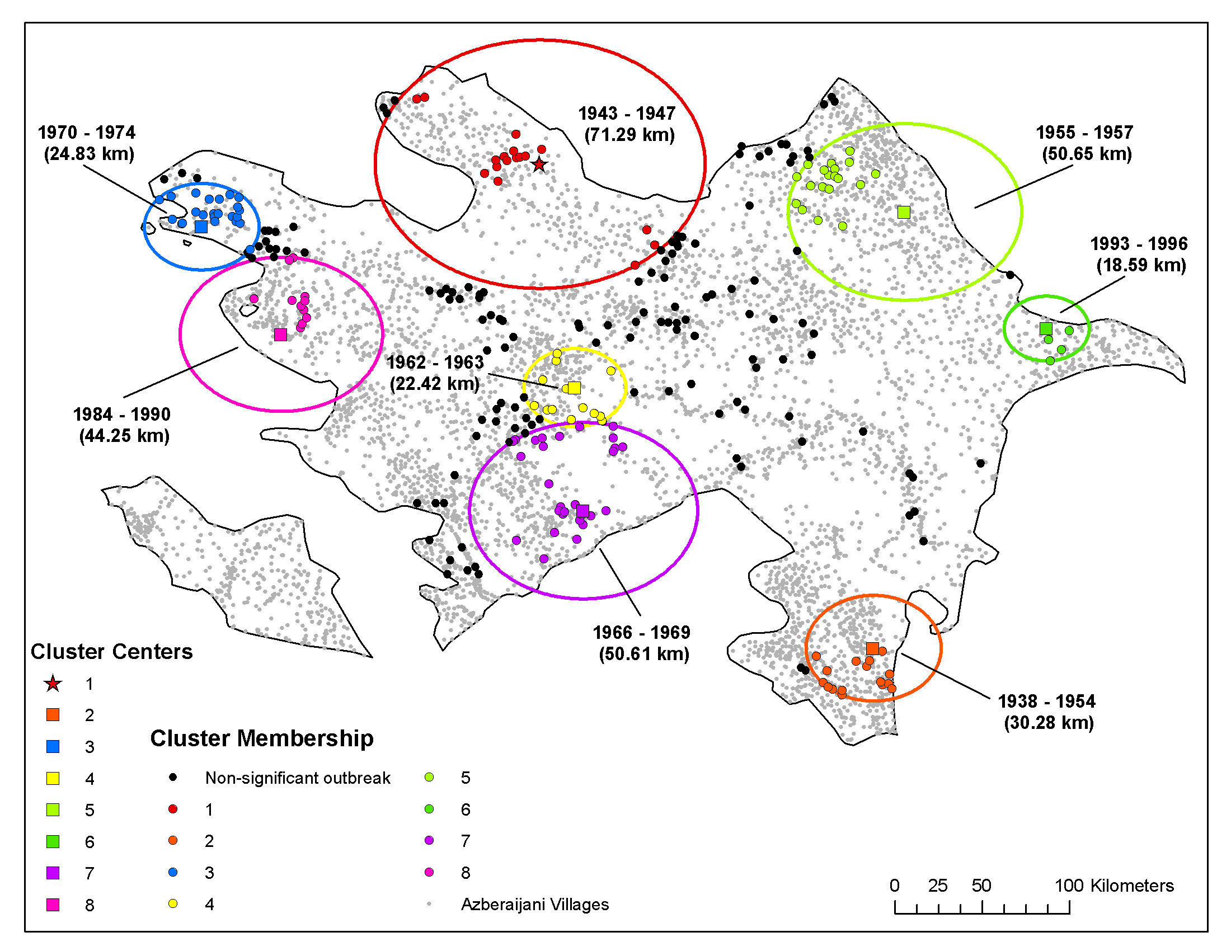

Slide 20
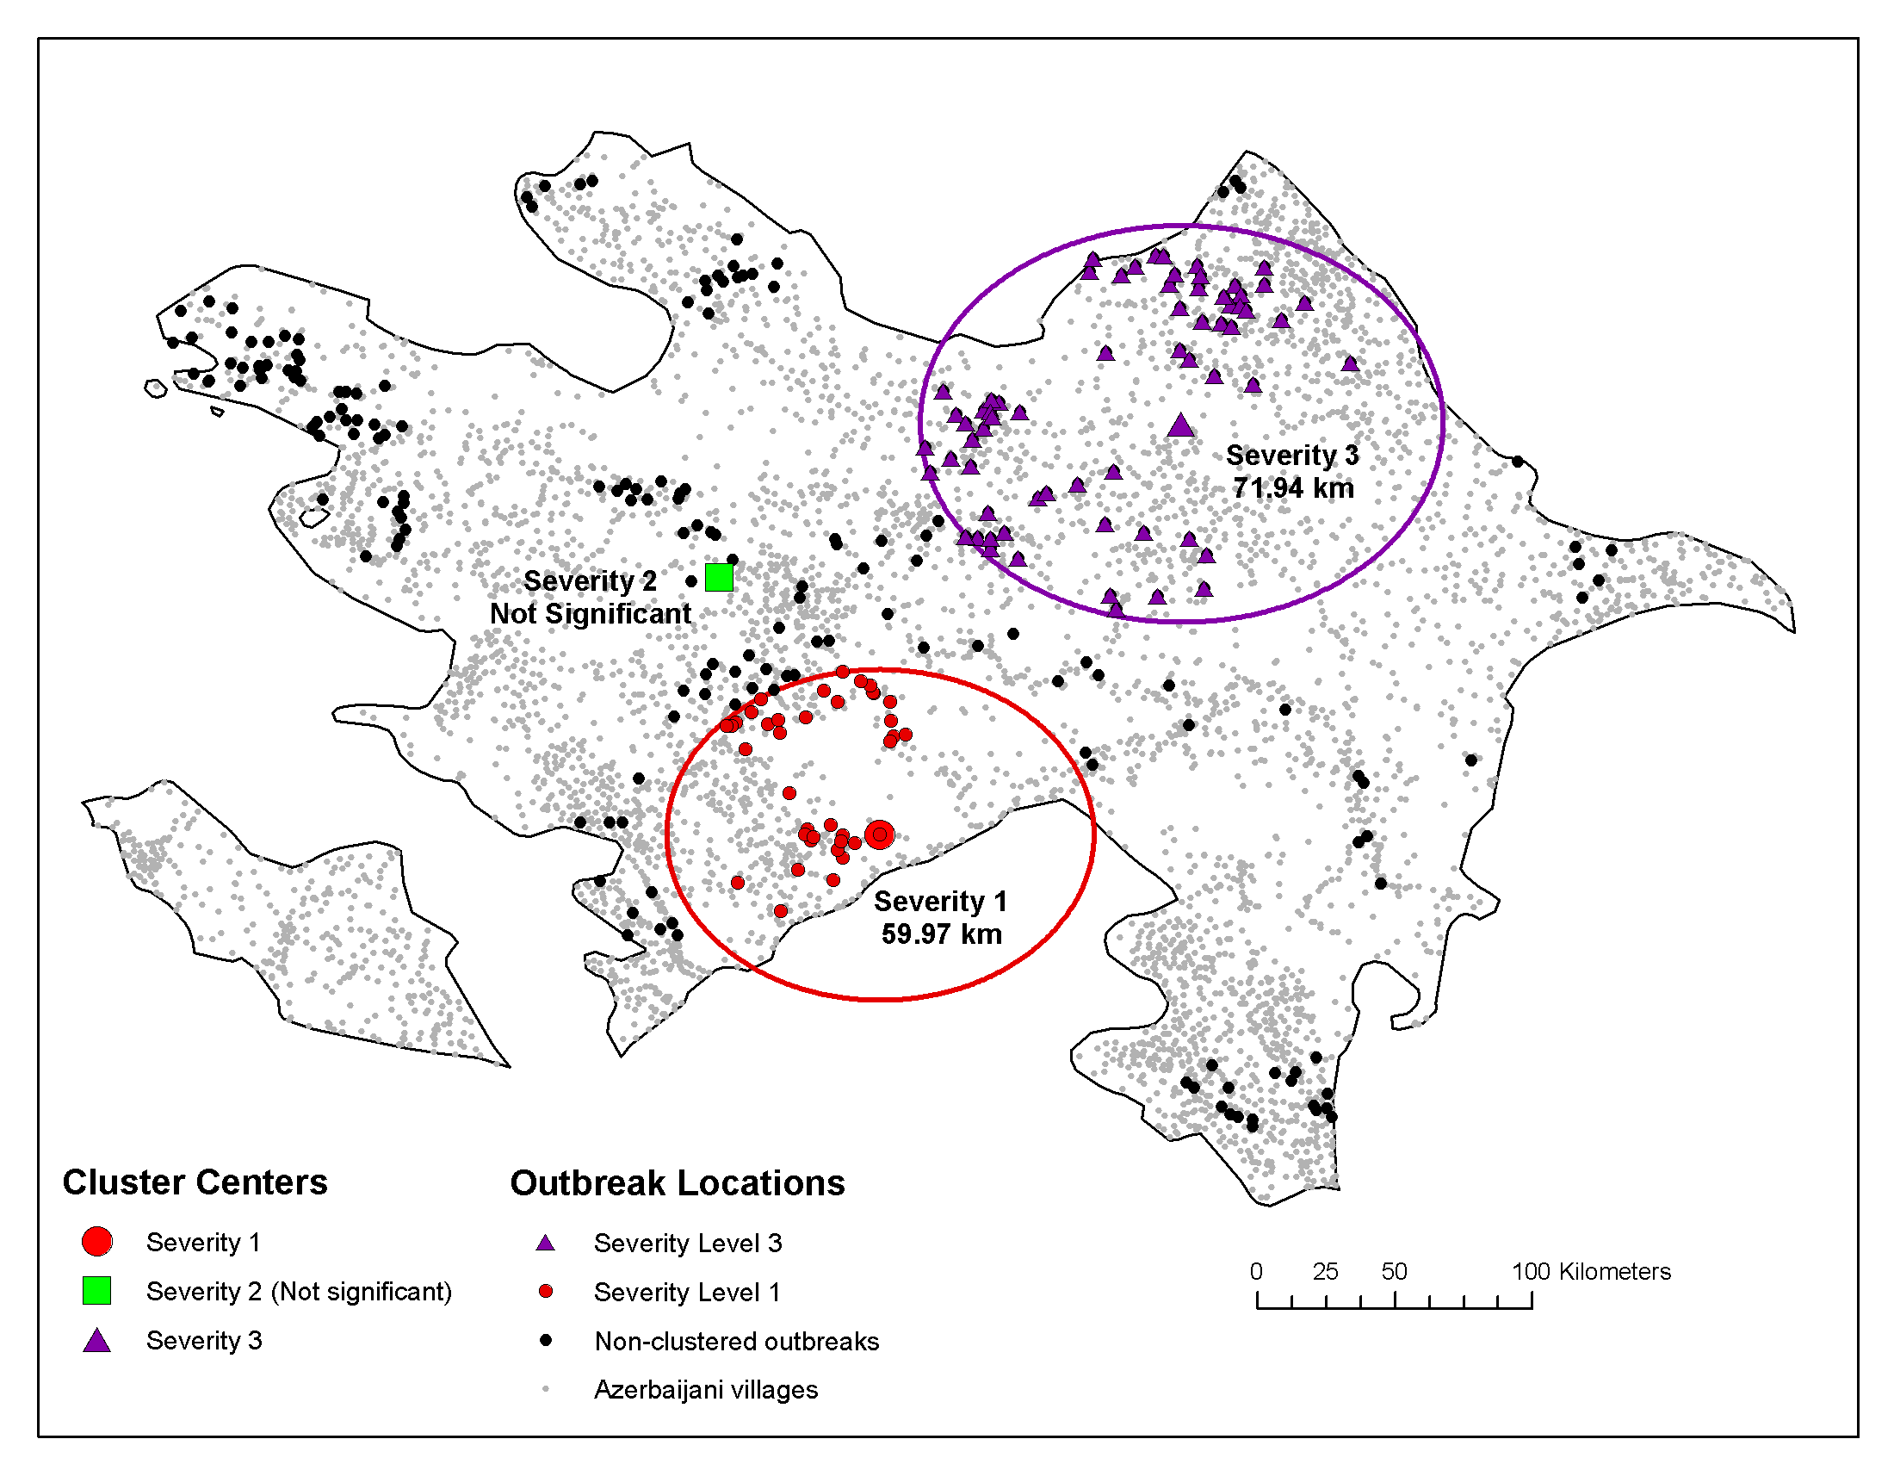

Slide 21
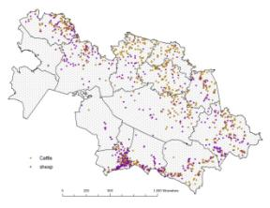
Cluster detection methods
Global clustering – defines if there Clustering or if some spatial distribution shows a significant (at some alpha) grouping in space, in space and time, or in time
Local clustering– defines where clusters are, structure/shape of clusters, scale of clusters
Employ point-pattern-analysis (PPA) or group-level spatial autocorrelation
Ripley’s K Plot (GLOBAL)
Yes. The observed data (black line) exceed the expected values across all distances.
Is there a significant pattern to these apparent groupings of cattle and sheep outbreaks?
Sagiyev et al. (2007, URISA, New Orleans – URISA GIS in Health Conference)

Slide 22
Group Level
•
0 | 1 | 0 | 0 | 0 | 3
1 | 2 | 0 | 1 | 0 | 0
0 | 1 | 0 | 2 | 0 | 0
1 | 0 | 2 | 1 | 0 | 0
0 | 0 | 2 | 4 | 0 | 1
0 | 1 | 0 | 0 | 0 | 0
1 | 0 | 1 | 2 | 1 | 1
•
•
•
•
•
•
•
•
•
•
•
•
•
•
•
•
•
•
•
•
•
•
•
•
•
•
•
•
Aggregated totals are assigned to each grid using Point in Polygon Counts
Locations are grouped aggregated to a grid system

